Slide 1


V Semester CSF
IT Data Security Lecture Series
Dr. Narendra Kumar Dewangan
Assistant Professor, Senior Scale
Systems, School of Computer Sciences
UPES Dehradun
Lecture-4

Slide 2
Network Based Threats
Security Vulnerabilities
DoS and D-DoS
Firewalls
Intrusion Detection Systems

Slide 3

Security Vulnerabilities
Security Problems in the TCP/IP Protocol Suite – Steve Bellovin - 89
Attacks on Different Layers
IP Attacks
ICMP Attacks
Routing Attacks
TCP Attacks
Application Layer Attacks

Slide 4
Why?
TCP/IP was designed for connectivity
Assumed to have lots of trust
Host implementation vulnerabilities
Software “had/have/will have” bugs
Some elements in the specification were left to the implementers

Slide 5
Security Flaws in IP
The IP addresses are filled in by the originating host
Address spoofing
Using source address for authentication
r-utilities (rlogin, rsh, rhosts etc..)
2.1.1.1
C
Can A claim it is B to the server S?
ARP Spoofing
Can C claim it is B to the server S?
Source Routing
Internet
1.1.1.3
S
A
1.1.1.1
1.1.1.2
B

Slide 6
Security Flaws in IP
IP fragmentation attack
End hosts need to keep the fragments till all the fragments arrive
Traffic amplification attack
IP allows broadcast destination
Problems?

Slide 7

Ping Flood
Internet
Attacking System
Broadcast Enabled Network
Victim System

Slide 8
ICMP Attacks
No authentication
ICMP redirect message
Can cause the host to switch gateways
Benefit of doing this?
Man in the middle attack, sniffing
ICMP destination unreachable
Can cause the host to drop connection
ICMP echo request/reply
Many more…
http://www.sans.org/rr/whitepapers/threats/477.php

Slide 9
Routing Attacks
Distance Vector Routing
Announce 0 distance to all other nodes
Blackhole traffic
Eavesdrop
Link State Routing
Can drop links randomly
Can claim direct link to any other routers
A bit harder to attack than DV
BGP
ASes can announce arbitrary prefix
ASes can alter path

Slide 10
TCP Attacks
SYN x
SYN y | ACK x+1
Client
ACK y+1
Server
Issues?
Server needs to keep waiting for ACK y+1
Server recognizes Client based on IP address/port and y+1

Slide 11
TCP Layer Attacks
TCP SYN Flooding
Exploit state allocated at server after initial SYN packet
Send a SYN and don’t reply with ACK
Server will wait for 511 seconds for ACK
Finite queue size for incomplete connections (1024)
Once the queue is full it doesn’t accept requests

Slide 12
TCP Layer Attacks
TCP Session Hijack
When is a TCP packet valid?
Address/Port/Sequence Number in window
How to get sequence number?
Sniff traffic
Guess it
Many earlier systems had predictable ISN
Inject arbitrary data to the connection

Slide 13
TCP Layer Attacks
TCP Session Poisoning
Send RST packet
Will tear down connection
Do you have to guess the exact sequence number?
Anywhere in window is fine
For 64k window it takes 64k packets to reset
About 15 seconds for a T1

Slide 14
Application Layer Attacks
Applications don’t authenticate properly
Authentication information in clear
FTP, Telnet, POP
DNS insecurity
DNS poisoning
DNS zone transfer

Slide 15
An Example
Finger
Showmount -e
SYN
Shimomura (S)
Trusted (T)
Finger @S
showmount –e
Send 20 SYN packets to S
Attack when no one is around
What other systems it trusts?
Determine ISN behavior
Mitnick

Slide 16
An Example
X
Syn flood
Shimomura (S)
Trusted(T)
Finger @S
showmount –e
Send 20 SYN packets to S
SYN flood T
Attack when no one is around
What other systems it trusts?
Determine ISN behavior
T won’t respond to packets
Mitnick

Slide 17
An Example
SYN|ACK
X
Shimomura (S)
ACK
SYN
trusted (T)
Finger @S
showmount –e
Send 20 SYN packets to S
SYN flood T
Send SYN to S spoofing as T
Send ACK to S with a guessed number
Attack when no one is around
What other systems it trusts?
Determine ISN behavior
T won’t respond to packets
S assumes that it has a session with T
Mitnick (M)

Slide 18
An Example
X
Shimomura (S)
Trusted (T)
++ > rhosts
Finger @S
showmount –e
Send 20 SYN packets to S
SYN flood T
Send SYN to S spoofing as T
Send ACK to S with a guessed number
Send “echo + + > ~/.rhosts”
Attack when no one is around
What other systems it trusts?
Determine ISN behavior
T won’t respond to packets
S assumes that it has a session with T
Give permission to anyone from anywhere
Mitnick

Slide 19
Outline
Security Vulnerabilities
DoS and D-DoS
Firewalls
Intrusion Detection Systems
You are here

Slide 20
Denial of Service
Objective → make a service unusable, usually by overloading the server or network
Consume host resources
TCP SYN floods
ICMP ECHO (ping) floods
Consume bandwidth
UDP floods
ICMP floods

Slide 21
Denial of Service
Crashing the victim
Ping-of-Death
TCP options (unused, or used incorrectly)
Forcing more computation
Taking long path in processing of packets

Slide 22
Simple DoS
The Attacker usually spoofed
source address to hide origin
Easy to block
Attacker
Victim
Victim
Victim

Slide 23
Coordinated DoS
Attacker
Attacker
Attacker
Victim
Victim
Victim
The first attacker attacks a different victim to cover up the real attack
The Attacker usually spoofed source address to hide origin
Harder to deal with

Slide 24
Distributed DoS
Attacker
Handler
Handler
Agent
Agent
Agent
Agent
Agent
Victim

Slide 25
Distributed DoS
The handlers are usually very high volume servers
Easy to hide the attack packets
The agents are usually home users with DSL/Cable
Already infected and the agent installed
Very difficult to track down the attacker
How to differentiate between DDoS and Flash Crowd?
Flash Crowd → Many clients using a service legimitaly
Slashdot Effect
Victoria Secret Webcast
Generally the flash crowd disappears when the network is flooded
Sources in flash crowd are clustered

Slide 26
Outline
Security Vulnerabilities
DoS and D-DoS
Firewalls
Intrusion Detection Systems
You are here

Slide 27
Firewalls
Lots of vulnerabilities on hosts in network
Users don’t keep systems up to date
Lots of patches
Lots of exploits in wild (no patch for them)
Solution?
Limit access to the network
Put firewalls across the perimeter of the network

Slide 28
Firewalls (contd…)
Firewall inspects traffic through it
Allows traffic specified in the policy
Drops everything else
Two Types
Packet Filters, Proxies
Internal Network
Firewall
Internet

Slide 29
Packet Filters
Packet filter selectively passes packets from one network interface to another
Usually done within a router between external and internal networks
screening router
Can be done by a dedicated network element
packet filtering bridge
harder to detect and attack than screening routers

Slide 30
Packet Filters Contd.
Data Available
IP source and destination addresses
Transport protocol (TCP, UDP, or ICMP)
TCP/UDP source and destination ports
ICMP message type
Packet options (Fragment Size etc.)
Actions Available
Allow the packet to go through
Drop the packet (Notify Sender/Drop Silently)
Alter the packet (NAT?)
Log information about the packet

Slide 31
Packet Filters Contd.
Example filters
Block all packets from outside except for SMTP servers
Block all traffic to a list of domains
Block all connections from a specified domain

Slide 32
Typical Firewall Configuration
Internet
Internal hosts can access DMZ and Internet
External hosts can access DMZ only, not Intranet
DMZ hosts can access Internet only
Advantages?
If a service gets compromised in DMZ it cannot affect internal hosts
DMZ
X
X
Intranet

Slide 33
Example Firewall Rules
Stateless packet filtering firewall
Rule → (Condition, Action)
Rules are processed in top-down order
If a condition satisfied – action is taken

Slide 34
Sample Firewall Rule
Allow SSH from external hosts to internal hosts
Two rules
Inbound and outbound
How to know a packet is for SSH?
Inbound: src-port>1023, dst-port=22
Outbound: src-port=22, dst-port>1023
Protocol=TCP
Ack Set?
Problems?
Client
Server
SYN
SYN/ACK
ACK
Rule
Dir
Src Addr
Src Port
Dst Addr
Dst Port
Proto
Ack Set?
Action
SSH-1
In
Ext
> 1023
Int
22
TCP
Any
Allow
SSH-2
Out
Int
22
Ext
> 1023
TCP
Yes
Alow

Slide 35
Default Firewall Rules
Egress Filtering
Outbound traffic from external address → Drop
Benefits?
Ingress Filtering
Inbound Traffic from internal address → Drop
Benefits?
Default Deny
Why?
Rule
Dir
Src Addr
Src Port
Dst Addr
Dst Port
Proto
Ack Set?
Action
Egress
Out
Ext
Any
Ext
Any
Any
Any
Deny
Ingress
In
Int
Any
Int
Any
Any
Any
Deny
Default
Any
Any
Any
Any
Any
Any
Any
Deny

Slide 36
Packet Filters
Advantages
Transparent to application/user
Simple packet filters can be efficient
Disadvantages
Usually fail open
Very hard to configure the rules
Doesn’t have enough information to take actions
Does port 22 always mean SSH?
Who is the user accessing the SSH?

Slide 37
Alternatives
Stateful packet filters
Keep the connection states
Easier to specify rules
More popular
Problems?
State explosion
State for UDP/ICMP?

Slide 38
Alternatives
Proxy Firewalls
Two connections instead of one
Either at transport level
SOCKS proxy
Or at application level
HTTP proxy
Requires applications (or dynamically linked libraries) to be modified to use the proxy

Slide 39
Proxy Firewall
Data Available
Application level information
User information
Advantages?
Better policy enforcement
Better logging
Fail closed
Disadvantages?
Doesn’t perform as well
One proxy for each application
Client modification

Slide 40
Outline
Security Vulnerabilities
DoS and DDoS
Firewalls
Intrusion Detection Systems
You are here

Slide 41
Intrusion Detection Systems
Firewalls allow traffic only to legitimate hosts and services
Traffic to the legitimate hosts/services can have attacks
CodeReds on IIS
Solution?
Intrusion Detection Systems
Monitor data and behavior
Report when identify attacks

Slide 42
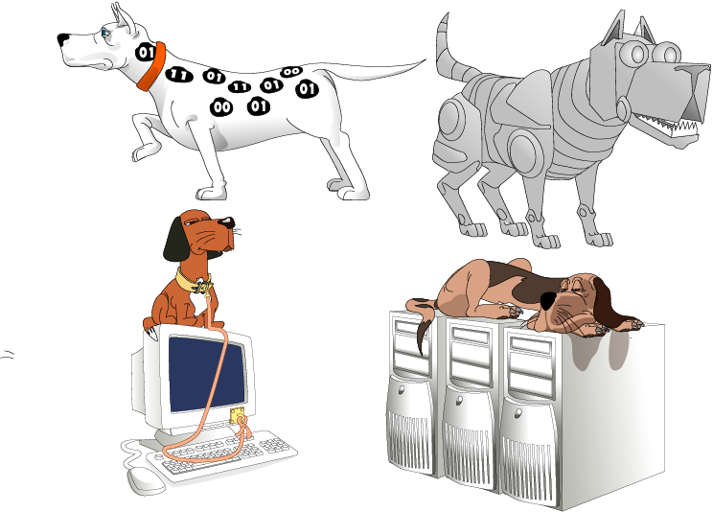
Types of IDS
Signature-based
Anomaly-based
Host-based
Network-based

Slide 43

Signature-based IDS
Characteristics
Uses known pattern matching to signify attack
Advantages?
Widely available
Fairly fast
Easy to implement
Easy to update
Disadvantages?
Cannot detect attacks for which it has no signature

Slide 44

Anomaly-based IDS
Characteristics
Uses statistical model or machine learning engine to characterize normal usage behaviors
Recognizes departures from normal as potential intrusions
Advantages?
Can detect attempts to exploit new and unforeseen vulnerabilities
Can recognize authorized usage that falls outside the normal pattern
Disadvantages?
Generally slower, more resource intensive compared to signature-based IDS
Greater complexity, difficult to configure
Higher percentages of false alerts

Slide 45

Network-based IDS
Characteristics
NIDS examine raw packets in the network passively and triggers alerts
Advantages?
Easy deployment
Unobtrusive
Difficult to evade if done at low level of network operation
Disadvantages?
Fail Open
Different hosts process packets differently
NIDS needs to create traffic seen at the end host
Need to have the complete network topology and complete host behavior

Slide 46

Host-based IDS
Characteristics
Runs on single host
Can analyze audit-trails, logs, integrity of files and directories, etc.
Advantages
More accurate than NIDS
Less volume of traffic so less overhead
Disadvantages
Deployment is expensive
What happens when host get compromised?

Slide 47
Summary
TCP/IP security vulnerabilities
Spoofing
Flooding attacks
TCP session poisoning
DOS and D-DOS
Firewalls
Packet Filters
Proxy
IDS
Signature and Anomaly IDS
NIDS and HIDS

Slide 48

Thank you

